Slide 1

Amazon Sales Data Analysis
VISUALIZATION
Udaya Lakshmi Punnam
0937129
Notes:
Good [morning/afternoon/evening], Professor.
Thank you for being here today to explore the fascinating world of data analytics with me.
My name is [Udaya Lakshmi Punnam], and I'm delighted to guide you through our presentation on 'Analyzing Amazon Sales Data for Strategic Insights.’
We'll delve into the wealth of information this dataset holds and uncover actionable insights to optimize sales strategies and drive business growth.”

Slide 2
Agenda
Introduction to Amazon Sales Data Analysis
Brief description of the Data
Visualization of the Data
Recommendations for Actionable Strategies
Notes:
Let's begin by outlining the agenda for our presentation, which will guide us through the key points we'll be covering today

Slide 3
Dataset
Source:
https://www.kaggle.com/datasets/gokulvino/amazon-sales-data-analysis-project1
Brief Description:
The dataset contains 100 observations with 14 variables of sales data from Amazon, detailing transactions including region, country, item type, sales channel, order details, units sold, pricing, and profitability.
It offers insights into Amazon's sales operations, helping analysts understand market trends, optimize strategies, and enhance profitability.
Nature of the Data:
The dataset is a Point-in-time sales data capturing transactions across different regions and product categories on Amazon.
Provides insights into sales volumes, pricing strategies, profitability, and geographic distribution of sales.

Slide 4
Sales around the world:
A profit & unit breakdown

Slide 5
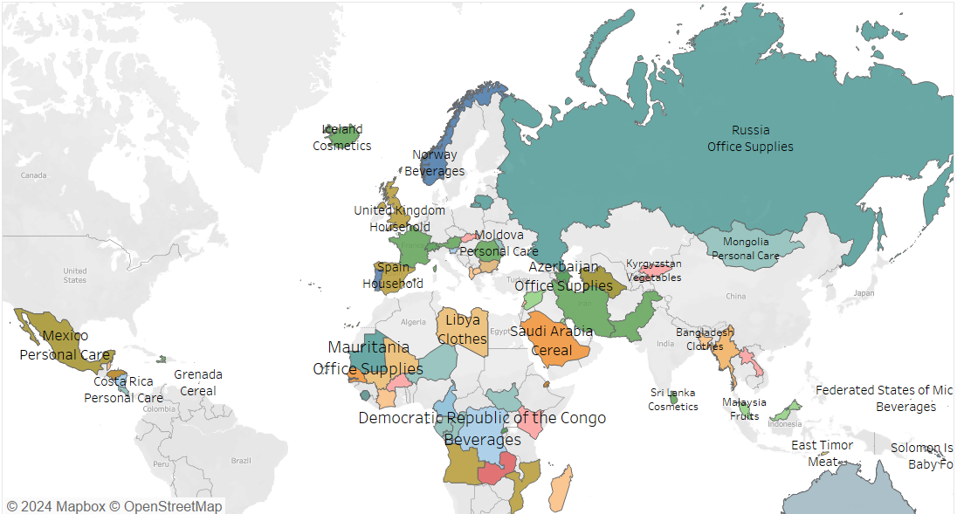
Sales around the world
A profit & Unit Breakdown
Notes:
This map provides a visual overview of the dominant product categories sold on Amazon across different countries.
The color coding represents the product category with the highest sales volume in each country, based on a sample dataset.
This map highlights the diversity of popular consumer goods across the globe.
It can be used to identify potential new markets for specific product categories.
It's important to note that the map only shows the dominant category and may not reflect the full range of products sold in each country.

Slide 6
Sales around the world
A profit & unit breakdown
Intended Goal:
Show geographic breakdown of sales profit and unit sales.
Questions Answered:
- Top profit & unit sales countries?
- Regional sales trends (profit vs. units)?
Improvements:
- Map: Clear world map with borders.
- Data: Dual-axis chart (profit & units) or colored map (profit/units).
- Colors: Easy-to-see & distinct.
- Legend: Explains color coding.

Slide 7
regional analysis: best-selling products overview

Slide 8
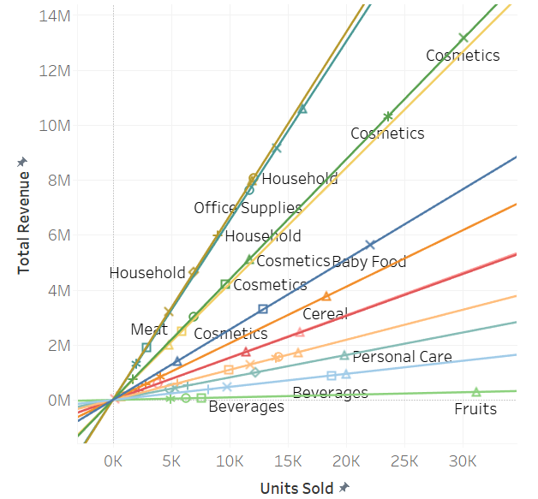
regional analysis
Best-Selling Products Overview
Notes:
This scatter plot with trend lines offers a deeper dive into the relationship between sales volume and product categories across different regions.
Each data point represents a product category in a specific region, with the x-axis indicating the sales volume and the y-axis representing a product category.
The trend lines show the general sales trends for product categories within each region.

Slide 9
Regional analysis
Best-selling products overview
Intended Goal:
Identify regional best-sellers and compare sales performance across regions.
Questions Answered:
- Which products are the best-sellers in each region?
Are there any regional variations in terms of product popularity?
Improvements:
- Chart: Use a bar chart (shows top sellers per region).
Data: Include sales figures (bar height or color intensity).
- Regions: Clearly differentiate with labels / colors / patterns

Slide 10
Visualizing product landscape: product category distribution

Slide 11
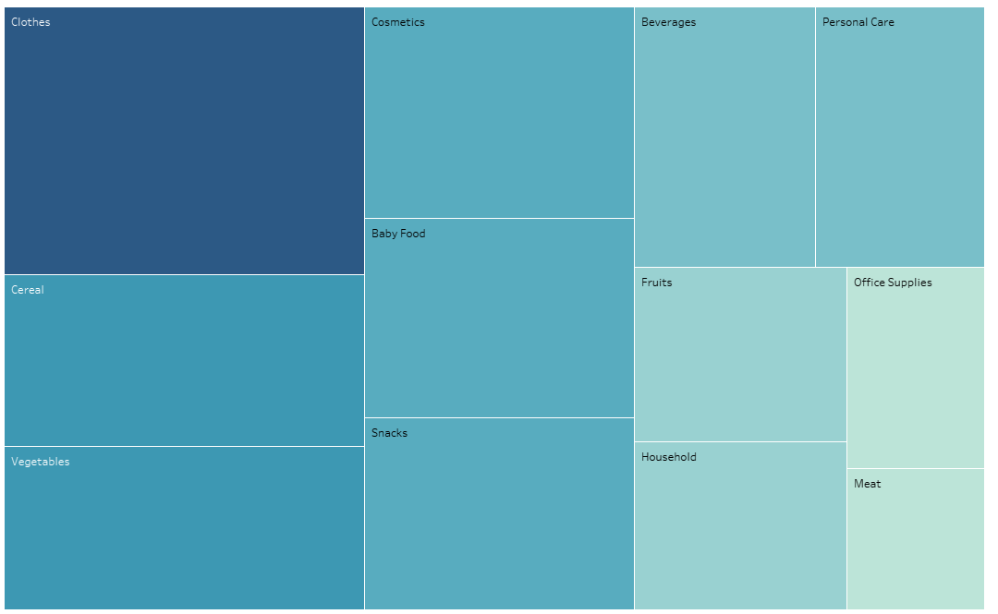
Visualizing product landscape
Product Category Distribution
Notes:
This treemap / heatmap chart provides a high-level overview of the distribution of product categories on Amazon. The nature of the colors represents the sales volume of each category (darker color indicate higher sales). The text labels in each box identify the product categories (e.g., Clothes, Beverages, Cosmetics).

Slide 12
Visualizing product landscape
Product category distribution
Intended Goal:
To show product category breakdown and prominence.
Questions Answered:
What product categories does the company offer?
Which product categories seem to be the most dominant based on visualization?
Improvements:
Chart: Use labeled pie / donut charts for clear category display.
Data: Include percentages / market share.
Colors: Use distinct and easy-to-see colors.

Slide 13
Recommendations
Combine findings: Look for connections across visualizations (e.g., high-selling regions and high-profit products).
Analyze trends: Investigate unexpected patterns in the data (e.g., sudden sales increase).
Build models: Use data to predict future sales and customer behavior.
Refine data: Clean and improve data quality for better analysis.
Visualize clearly: Make visualizations clear and consider interactivity.

Slide 14
Thank you

